Slide 1

Anomaly Detection and Recommender Systems.

Slide 2
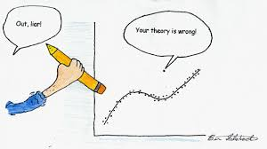
Is it OK to remove an outlier?
Notes:
Discuss this questions.

Slide 3


Motivation
Fraud detection.
Manufacturing.
Monitoring computers in a data center.
Notes:
Draw circles around the data like normal curve, and write the probabilities of the point (x) be in side the circles if it is grater than some threshold (density estimation).

Slide 4



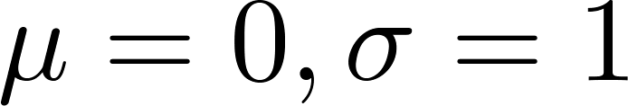
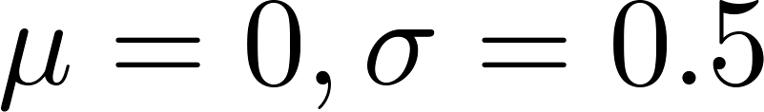
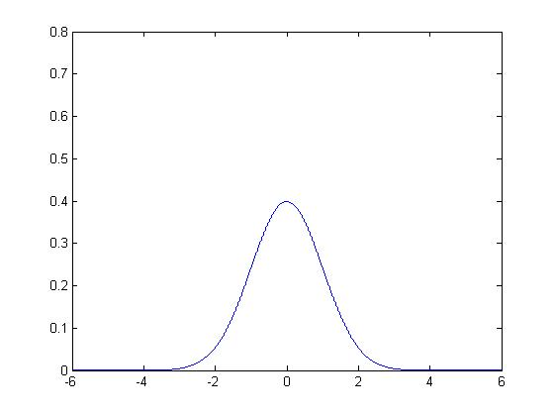
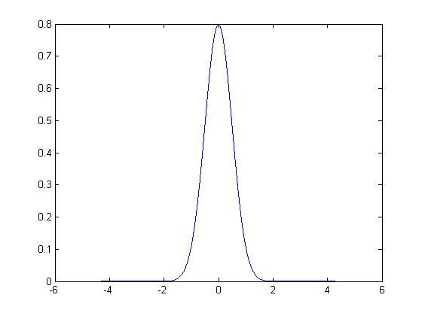
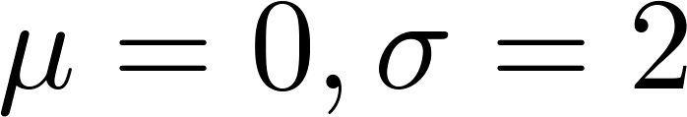
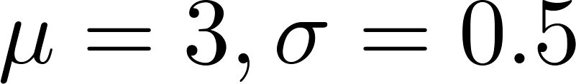
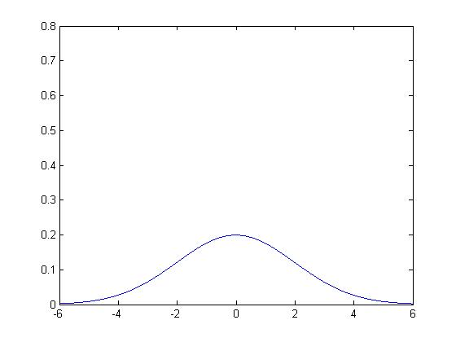
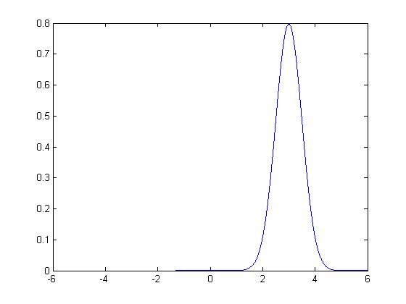
Gaussian (Normal) distribution
Say . If is a distributed Gaussian with mean , variance .
Notes:
Draw normal distribution.

Slide 5

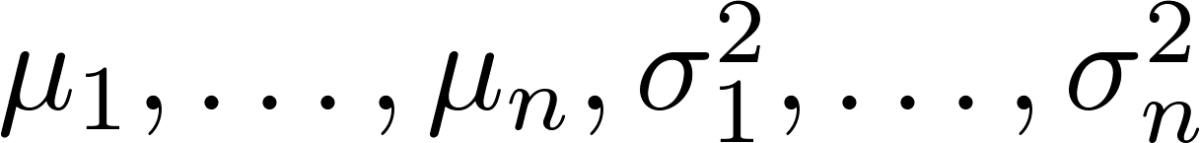
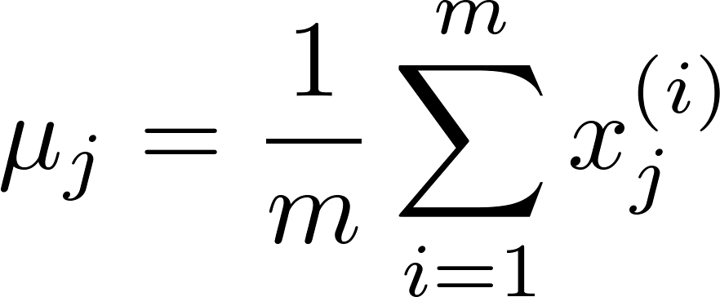
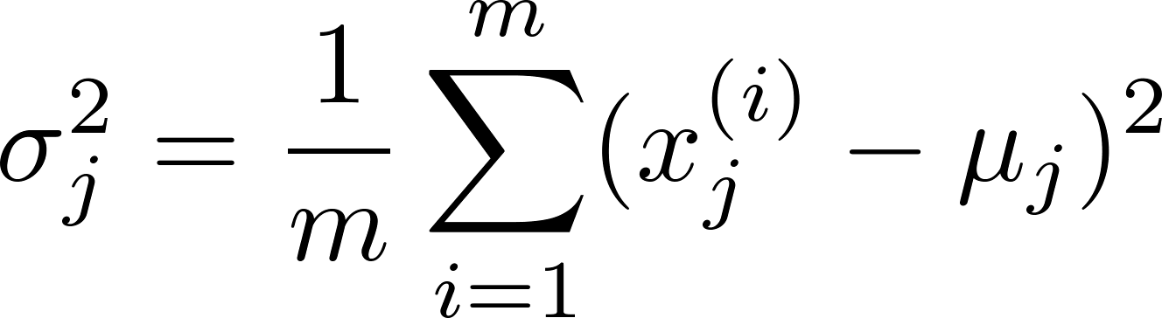

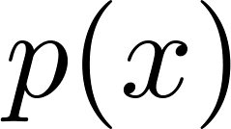
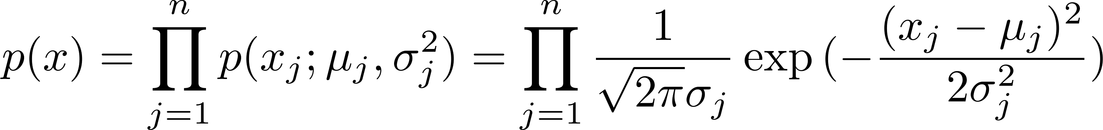
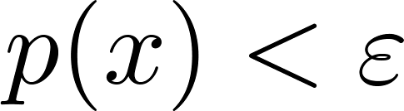
Anomaly detection algorithm
Choose features that you think might be indicative of anomalous examples.
Fit parameters
Given new example , compute :
Anomaly if
Notes:
Change numbers to LATEX as well

Slide 6
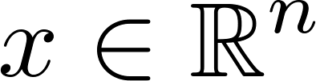
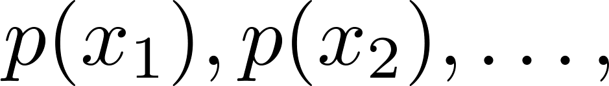
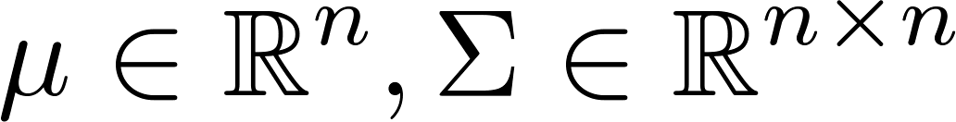
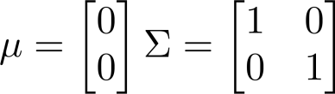
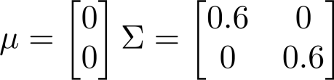
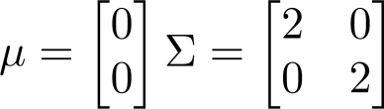
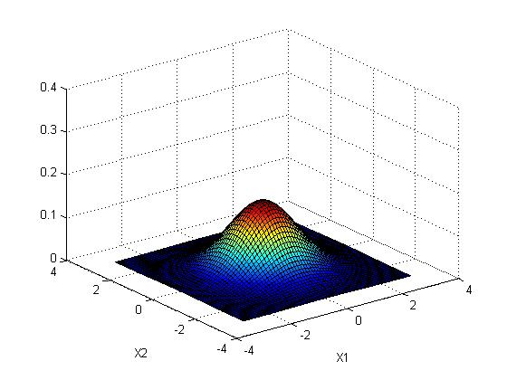
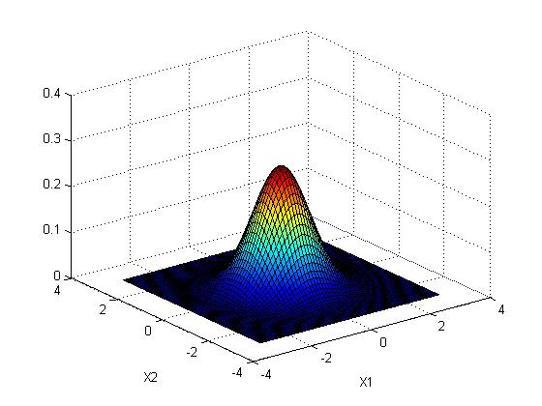
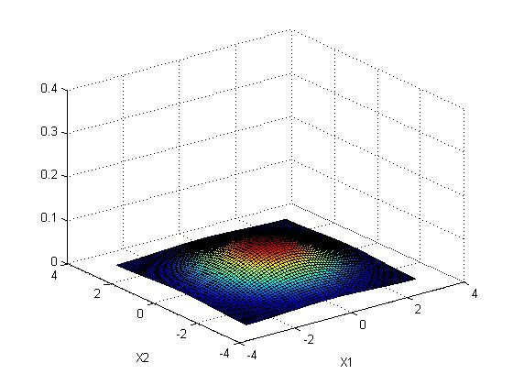
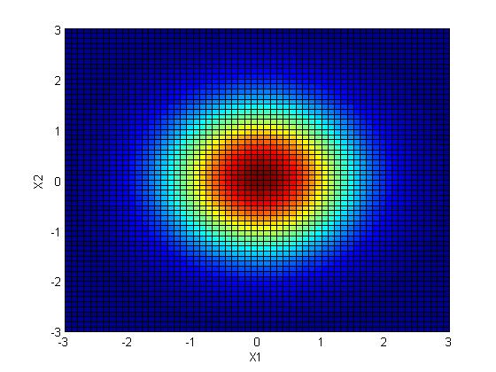
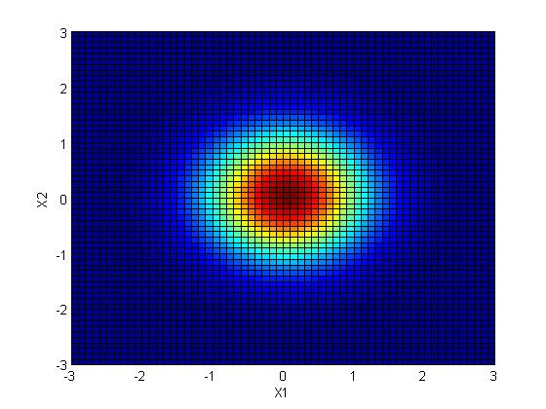
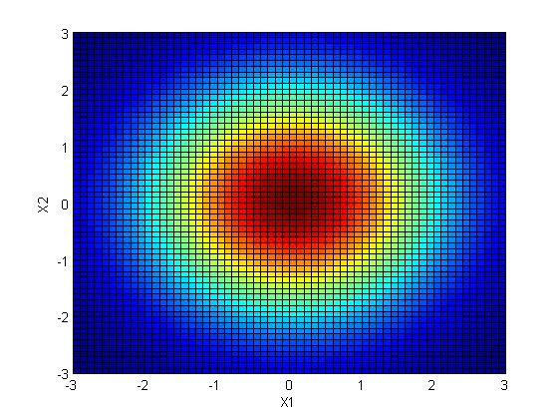
Multivariate Gaussian (Normal) distribution
. Don’t model etc. separately. Model all in one go.
Parameters: (covariance matrix)
Notes:
Draw the equation of the distribution.
Explain the change in parameters and the corresponding in the graph.

Slide 7
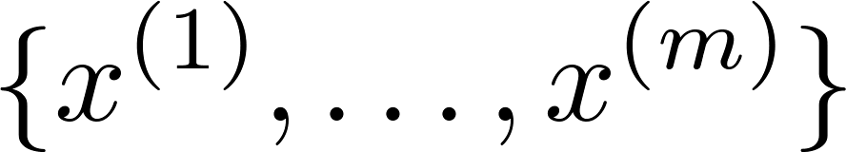
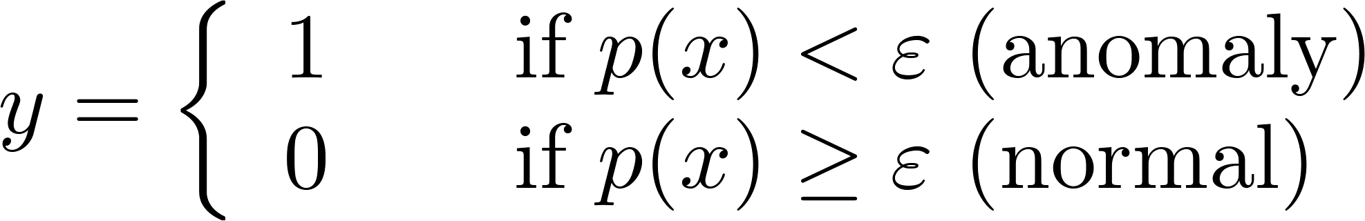

Algorithm evaluation
Fit model on training set
On a cross validation/test example , predict
Possible evaluation metrics:
- True positive, false positive, false negative, true negative
- Precision/Recall
- F₁-score
Can also use cross validation set to choose parameter
Notes:
Speak about different evaluation metrics and explain them.

Slide 8


Anomaly detection
vs.
Supervised learning
Very small number of positive examples ( ). (0-20 is common).
Large number of negative ( ) examples.
Many different “types” of anomalies. Hard for any algorithm to learn from positive examples what the anomalies look like; future anomalies may look nothing like any of the anomalous examples we’ve seen so far.
Large number of positive and negative examples.
Enough positive examples for algorithm to get a sense of what positive examples are like, future positive examples likely to be similar to ones in training set.
Notes:
Make points have 0 mean on x1 and x2

Slide 9
Recommender Systems

Slide 10





Recommender Systems
Example: Predicting movie ratings
User rates movies using one to five stars
Movie | Alice (1) | Bob (2) | Carol (3) | Dave (4)
Love at last
Romance forever
Cute puppies of love
Nonstop car chases
Swords vs. karate
= no. users
= no. movies
= 1 if user has rated movie
= rating given by user to movie (defined only if
)
Notes:
Draw some values to the rating of each move and some are missing, and ask the question how can we predict the missing value?
( data mgalling , linear regression,… etc.)
Draw the linear regression $θ^{T}x$ equation.

Slide 11






Problem formulation
if user has rated movie (0 otherwise)
rating by user on movie (if defined)
= parameter vector for user
= feature vector for movie
For user , movie , predicted rating:
= no. of movies rated by user
To learn :
Notes:
After to learn draw linear regression cost function.

Slide 12
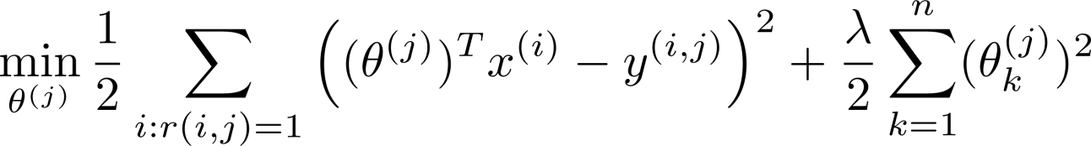
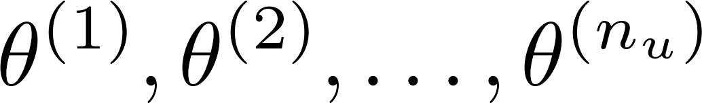
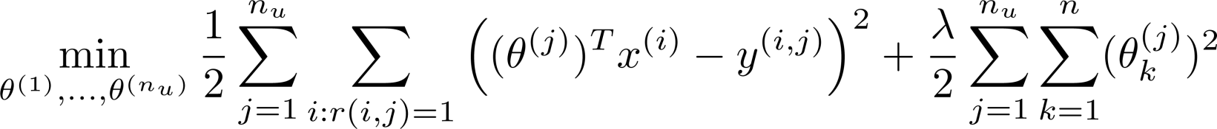
Optimization objective:
To learn (parameter for user ):
To learn :

Slide 13
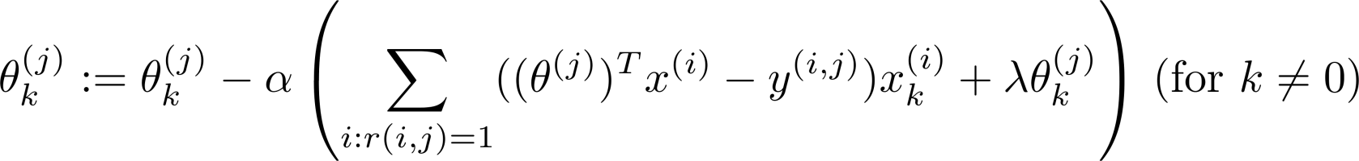
Optimization algorithm:
Gradient descent update:

Slide 14
Collaborative filtering

Slide 15
Problem motivation
Movie | Alice (1) | Bob (2) | Carol (3) | Dave (4) | (romance) | (action)
Love at last | 5 | 5 | 0 | 0 | 0.9 | 0
Romance forever | 5 | ? | ? | 0 | 1.0 | 0.01
Cute puppies of love | ? | 4 | 0 | ? | 0.99 | 0
Nonstop car chases | 0 | 0 | 5 | 4 | 0.1 | 1.0
Swords vs. karate | 0 | 0 | 5 | ? | 0 | 0.9
Notes:
Introduce the Xs as variables to predict the move type like by people base on the rating (linear regression)

Slide 16
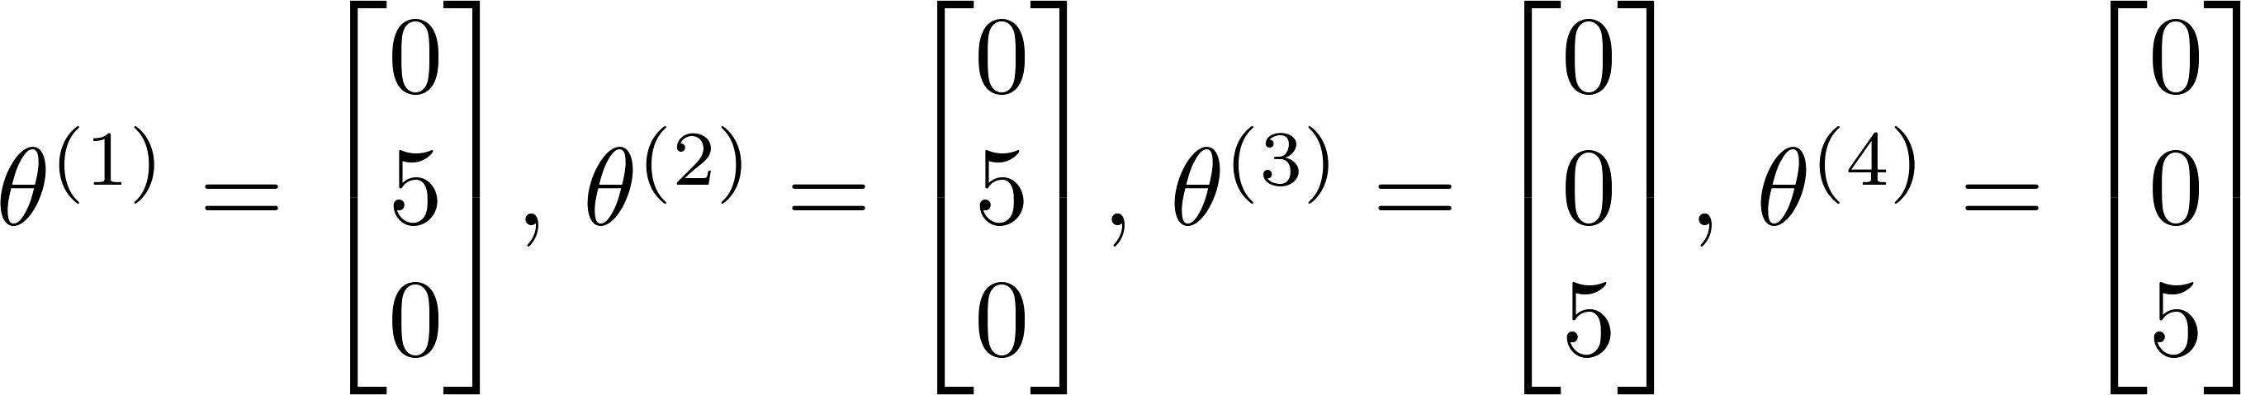
Problem motivation
Movie | Alice (1) | Bob (2) | Carol (3) | Dave (4) | (romance) | (action)
Love at last | 5 | 5 | 0 | 0 | ? | ?
Romance forever | 5 | ? | ? | 0 | ? | ?
Cute puppies of love | ? | 4 | 0 | ? | ? | ?
Nonstop car chases | 0 | 0 | 5 | 4 | ? | ?
Swords vs. karate | 0 | 0 | 5 | ? | ? | ?
Notes:
As what if we don’t know the $x_{1} \&{ x}_{1}$ what can we do (we know that they are linearly related with the rating)?
Draw the linear regression $θ^{T}x$ equation using the given thetas for each person.

Slide 17
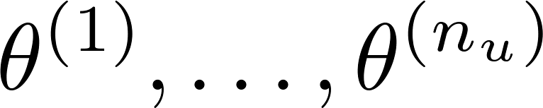

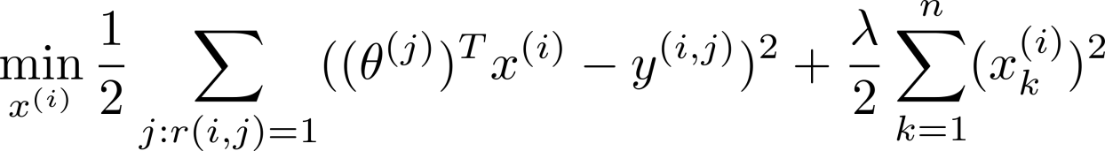
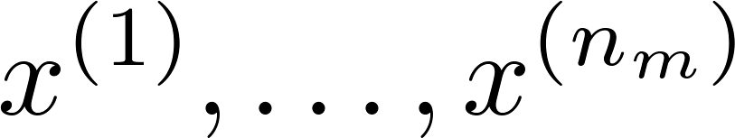
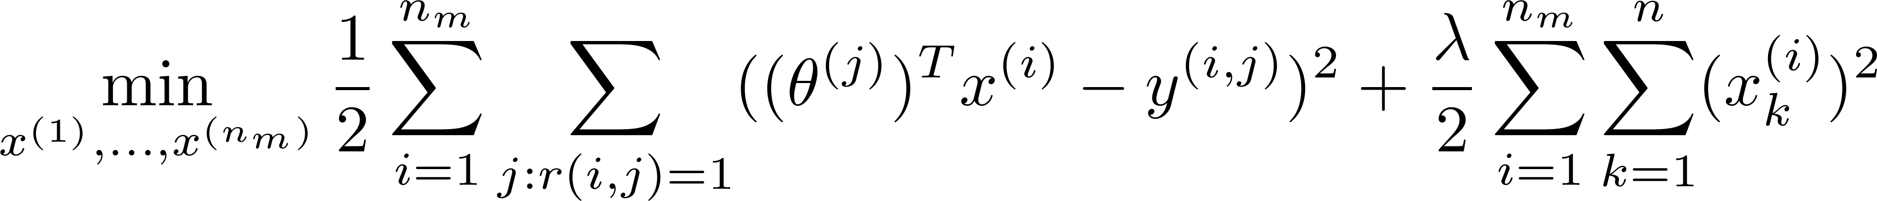
Optimization algorithm
Given , to learn :
Given , to learn :

Slide 18
Collaborative filtering
Given (and movie ratings),
can estimate
Given ,
can estimate
Notes:
Draw that we predict the thetas then the Xs and the thetas then the Xs , as so on.

Slide 19
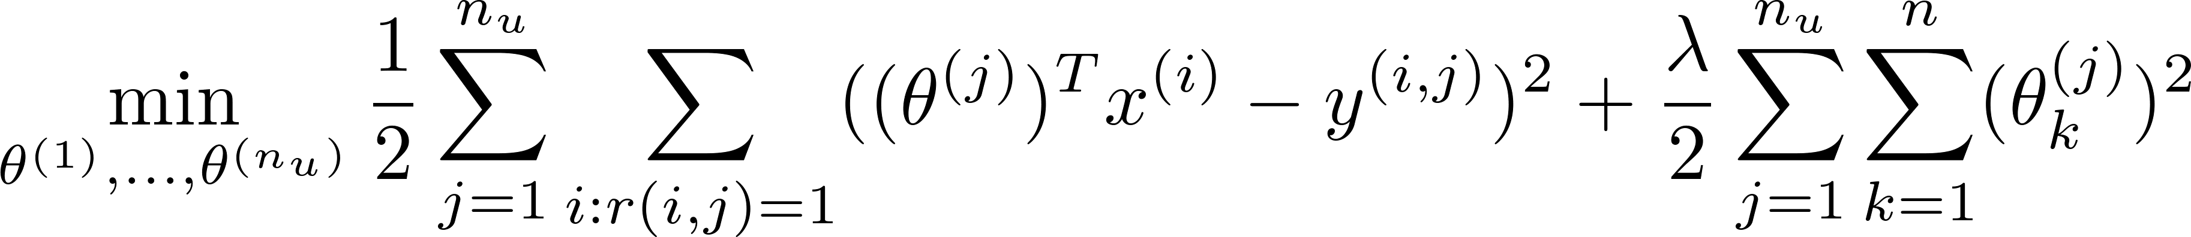

Collaborative filtering optimization objective
Given , estimate :
Given , estimate :
Minimizing and simultaneously:

Slide 20
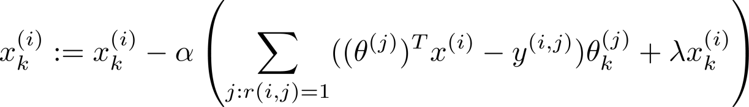
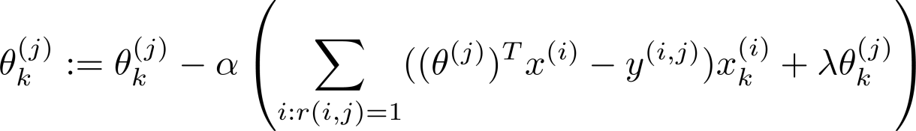

Collaborative filtering algorithm
Initialize to small random values.
Minimize using gradient descent (or an advanced optimization algorithm). E.g. for every:
For a user with parameters and a movie with (learned) features , predict a star rating of .

